Slide 1


Muhammad Aftab
Jul 31,2025

Slide 2

Outline
Executive Summary
Introduction
Methodology
Results
Conclusion
Appendix

Slide 3
Executive summary
Methodology:
1.Data Collection
2.Data Wrangling
3.Exploratory Data Analysis
4.SQL Queries
5.Interactive Visualization
6.Predictive Analysis
Results
Clean CSV datasets with enriched feature set.
Result in clean and handled values
Visualization of different variables in different graphs
Using sql queries to gain different result
Using folium to develop interactive dashboard
Using different algorithm to gain better accuracy

Slide 4
Introduction
Project Background: In this project we use SPACEX launching data of different boosters from different launching sites. In this we will find that a rocket booster will successfully land or not
Problem Answers: By using the SPACEX dataset we will try to find the answers like a specific launching booster will land or not

Slide 5

Section 1

Slide 6
Methodology
Executive Summary
Data collection methodology:
Data was collected by using SPACEX API and web scrapping tools from SPACEX website
Perform data wrangling
Data was processed to clean and normalize the data to a standard format
Perform exploratory data analysis (EDA) using visualization and SQL
Perform interactive visual analytics using Folium and Plotly Dash
Perform predictive analysis using classification models
In Predictive analysis we use different algorithms like LinearRegression, DecssionTrees, SVM and KNNeighbore

Slide 7
Data Collection
The data was collected from the SPACEX website by using the API and web scrapping tools like requests, BeautifulSoup libraries.
Start
Call SPACEX Rest API
Parse Json Response
Extract Relevant Fields
Convert to DataFrame
Save as CSV

Slide 8
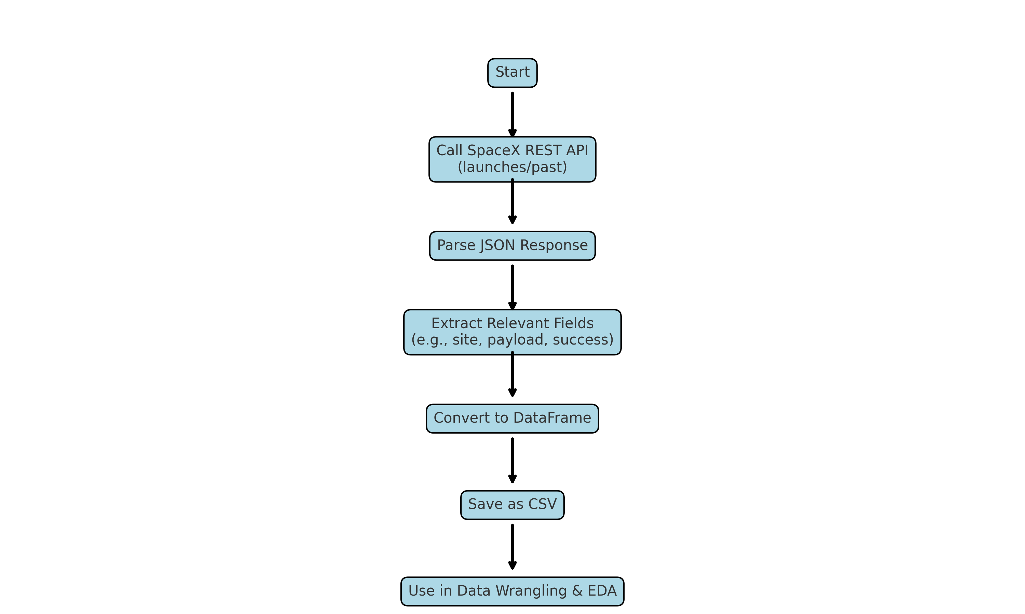
Data Collection – SpaceX API
Present your data collection with SpaceX REST calls using key phrases and flowcharts
GitHub URL:
https://github.com/Muhammad-Aftab-web/DataScience_Coursera/blob/main/jupyter-labs-spacex-data-collection-api-v2.ipynb

Slide 9
Data Collection - Scraping
Start
Key Phrases:
Target Identification – Define website(s) to extract data from.
Inspect HTML Structure – Use browser DevTools to locate elements/tags.
Request & Retrieve – Send HTTP GET requests to web pages.
Parse HTML Content – Use libraries like BeautifulSoup or lxml to extract data.
Extract Required Data – Filter relevant tags, attributes, or text.
Clean & Format Data – Remove unwanted characters, handle missing values.
Store Data – Save to CSV, JSON, database, or DataFrame.
Automate & Repeat – Use loops/schedulers to scrape multiple pages or refresh.
GitHub URL:
https://github.com/Muhammad-Aftab-web/DataScience_Coursera/blob/main/SPACEX_WebScrapping.ipynb
Identify Target Web
Inspect Web Page Structure
Send HTTP Request
Receive and Parse HTML
Extract Desired Info
Clean and Structured Data
Save to CSV / DB / DataFrame
Repeat or Schedule
End

Slide 10
Data Wrangling
Data was process by following the steps which are given below
Key Phrases for Data Wrangling Process
Load Raw Data – Import data from CSV, API, web, or database.
Inspect Data – Use head(), info(), and describe() to understand structure and quality.
Handle Missing Values – Impute, drop, or flag null entries.
Fix Data Types – Convert strings to dates, floats to integers, etc.
Remove Duplicates – Identify and drop repeated records.
Standardize Formats – Ensure consistency in date formats, capitalization, units.
Filter & Select Relevant Data – Remove unnecessary rows or columns.
Feature Engineering – Create new variables from existing data.
Final Cleaned Dataset – Save/export the wrangled data for analysis.
GitHub URL: https://github.com/Muhammad-Aftab-web/DataScience_Coursera/blob/main/SPACEX_DataWrangling.ipynb
Start
Load Raw Data
Inspect Data
Handle Missing Value
Fix Data Types
Remove Duplicates
Standardize Formats
Filter & Select Relevant Data
Feature Engineering
Final Cleaned Dataset
End

Slide 11
EDA with Data Visualization
Charts Used: The chart used in this notebook are like scatter plot, catplot and barplot to show the relationship between variables like for scatter and cat plot the variables used are Payload, LaunchSite, Flight Number and Orbit. For barplot we used Class_mean by Orbit and finaly For Line Plot we used Year and Success Rate variables
GitHub URL : https://github.com/Muhammad-Aftab-web/DataScience_Coursera/blob/main/SPACEX_EDA_Visualiztioni.ipynb

Slide 12
EDA with SQL
SQL Queries: The queries used in this notebook are as
select distinct launch sites
Select launch sites where launch sites begin with CCA characters
Select the total Payload mass of Nasa boosters
Select average payload mass carried by booster version F9 v1.1
Select the first date when Ground pad launch was successful
Selecting the names of the boosters which have success in drone ship and have payload mass greater than 4000 but less than 6000
GitHub URL: https://github.com/Muhammad-Aftab-web/DataScience_Coursera/blob/main/SPACEX_EDA_SQL.ipynb

Slide 13
Build an Interactive Map with Folium
Folium Objects: The folium objects like marker, circle and other in the notebook are used to represent the launch sites location on the map by marking it using pop up and pointing the successful and fail launching of each launching site
GitHub URL: https://github.com/Muhammad-Aftab-web/DataScience_Coursera/blob/main/SPACEX_LaunchSite_Loc.ipynb

Slide 14
Build a Dashboard with Plotly Dash
Plotly Plots: The plots used in this labs are pie chart to represent the successful and fail launching of each launching site and other plot were range slide
Purpose: We used these plot to give an interactive presentation
GitHub URL:

Slide 15
Predictive Analysis (Classification)
Load Datasets
Model Development: The models used in this notebook are used to solve classification problem which was that a booster will land safely or not on a pad. The algorithms used in this notebook are LinearRegression, Decision Tree, KNNeighbore, and SVM in a GridSearchCV
GitHub URL : https://github.com/Muhammad-Aftab-web/DataScience_Coursera/blob/main/SpaceX-Machine-Learning-Prediction-Part-5-v1.ipynb
Feature Matrix X and Target y
Data Preprocessing (StandardScaler)
Split Data into Train/Test Split
Model Selection & Hyperparameter Tuning
Train Classifiers (Logistic Regression, SVM, etc).
Evaluate Models using Confusion Matrix
Select Best Performing Model
End

Slide 16
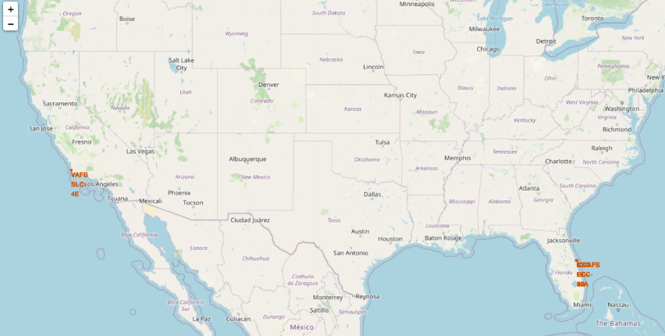
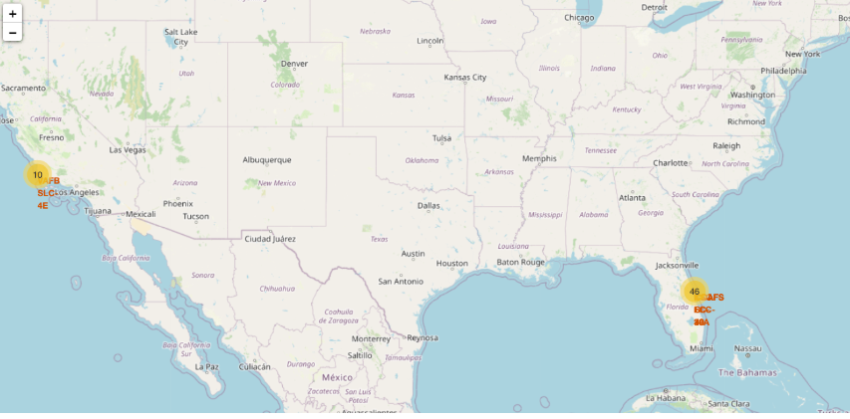
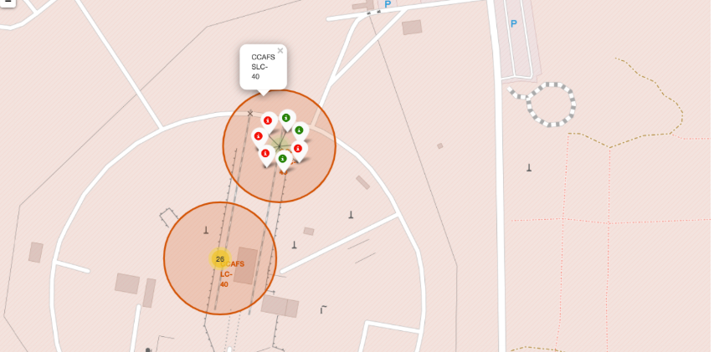
Results
Interactive analytics demo screen shotes:
Predictive Analysis results:
1.GridSearchCv(LinearRegression()): print("tuned hpyerparameters :(best parameters) ",lr_cv.best_params_) print("accuracy :",lr_cv.best_score_) -> tuned hpyerparameters :(best parameters) {'C': 0.1, 'penalty': 'l2', 'solver': 'lbfgs'} accuracy : 0.8342857142857143
2.GridSearchCV(Decision Tree) : print("tuned hpyerparameters :(best parameters) ",tree_cv.best_params_) print("accuracy :",tree_cv.best_score_) -> tuned hpyerparameters :(best parameters) {'criterion': 'gini', 'max_depth': 12, 'max_features': 'sqrt', 'min_samples_leaf': 2, 'min_samples_split': 10, 'splitter': 'random'} accuracy : 0.8625
3.GridSearchCV(SVM()) : print("tuned hpyerparameters :(best parameters) ",svm_cv.best_params_) print("accuracy :",svm_cv.best_score_) ->tuned hpyerparameters :(best parameters) {'C': np.float64(1.0), 'gamma': np.float64(0.03162277660168379), 'kernel': 'sigmoid'} accuracy : 0.8482142857142856
4.GridSearchCV(KNNeighbors()): print("tuned hpyerparameters :(best parameters) ",knn_cv.best_params_) print("accuracy :",knn_cv.best_score_) tuned hpyerparameters :(best parameters) {'algorithm': 'auto', 'n_neighbors': 10, 'p': 1} accuracy : 0.8482142857142858
5. Best Model : models = {'Logistic Regression': lr_cv, 'SVM': svm_cv, 'Decision Tree': tree_cv, 'KNN': knn_cv} best_model = max(models, key=lambda x: models[x].best_score_) print("Best model is: ", best_model) Best model is: Decision Tree

Slide 17

Section 2

Slide 18
Flight Number vs. Launch Site
Show a scatter plot of Flight Number vs. Launch Site
Show the screenshot of the scatter plot with explanations

Slide 19
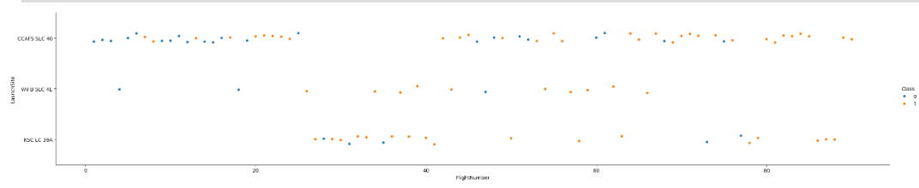
Payload vs. Launch Site
We can see that as the flight number increases, the first stage is more likely to land successfully. The payload mass is also important; it seems the more massive the payload, the less likely the first stage will return.

Slide 20
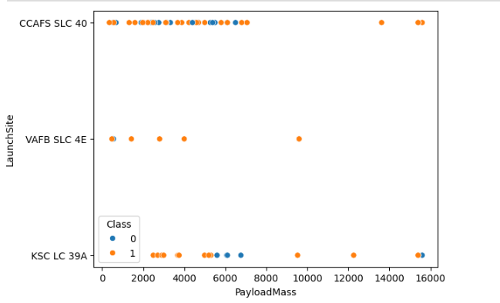
Payload_Mass vs. Launch Site
As shown in the pic there are few boosters that has payload mass greater than 10000 which are almost successful

Slide 21
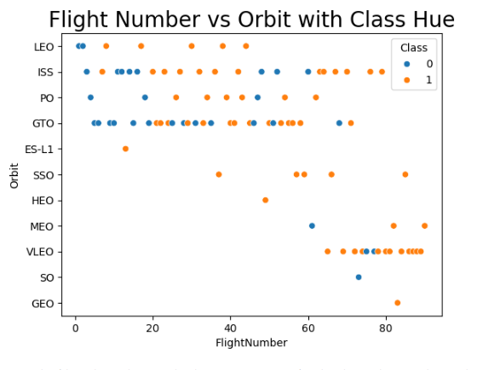
Flight Number vs. Orbit Type
We can see that in the LEO orbit the Success appears related to the number of flights; on the other hand, there seems to be no relationship between flight number when in GTO orbit.

Slide 22
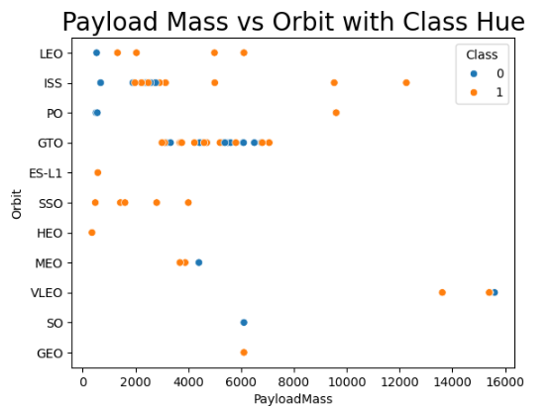
Payload vs. Orbit Type
With heavy payloads the successful landing or positive landing rate are more for Polar,LEO and ISS.
However for GTO we cannot distinguish this well as both positive landing rate and negative landing(unsuccessful mission) are both there here.

Slide 23
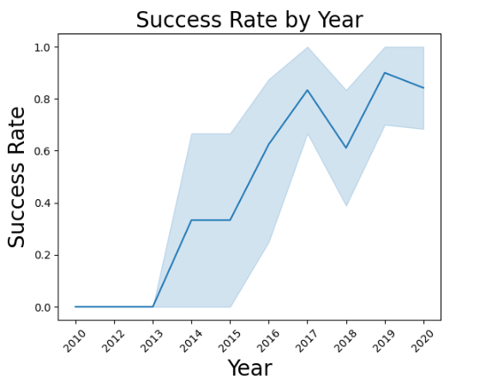
Launch Success Yearly Trend
We can observe that the success rate since 2013 kept increasing till 2017 (stable in 2014) and after 2015 it started increasing.

Slide 24
Unique Launch Site Names
Launch_Site
CCAFS LC-40
VAFB SLC-4E
KSC LC-39A
CCAFS SLC-40
We use Distinct query on SPACEXTABLE to get unique launching sites of spacex company through which rockets were launched

Slide 25
Launch Site Names Begin with 'CCA'
Launch_Site
CCAFS LC-40
CCAFS LC-40
CCAFS LC-40
CCAFS SLC-40
CCAFS SLC-40
These are the Spacex company launching sites begin with CCA from SPACEXTABLE

Slide 26
Total Payload Mass
total_payload
48213

Slide 27
Average Payload Mass by F9 v1.1
average_payload | Booster_Version
2534.6666666666665 | F9 v1.1 B1003
Average Payload mass is calculated by using the avg() function of sql query where booster name start with F9 v1.1 B1003

Slide 28
First Successful Ground Landing Date
first_successful_landing
2015-12-22
The first landing date of successful booster on ground pad which is find by using the min function on Date variable where booster landing outcome is success(ground pad)

Slide 29
Successful Drone Ship Landing with Payload between 4000 and 6000
Booster_Version | PAYLOAD_MASS__KG_
F9 FT B1022 | 4696
F9 FT B1026 | 4600
F9 FT B1021.2 | 5300
F9 FT B1031.2 | 5200
The boosters with payload mass between 4000 and 6000 is found by query with Between and function

Slide 30
Total Number of Successful and Failure Mission Outcomes
Landing_Outcome | total_landings
Failure | 3
Failure (drone ship) | 5
Failure (parachute) | 2
Success | 38
Success (drone ship) | 14
Success (ground pad) | 9

Slide 31
Booster_Version | PAYLOAD_MASS__KG_
F9 B5 B1048.4 | 15600
F9 B5 B1049.4 | 15600
F9 B5 B1051.3 | 15600
F9 B5 B1056.4 | 15600
F9 B5 B1048.5 | 15600
F9 B5 B1051.4 | 15600
F9 B5 B1049.5 | 15600
F9 B5 B1060.2 | 15600
F9 B5 B1058.3 | 15600
F9 B5 B1051.6 | 15600
F9 B5 B1060.3 | 15600
F9 B5 B1049.7 | 15600
Boosters Carried Maximum Payload

Slide 32
2015 Launch Records
month | Landing_Outcome | Booster_Version | Launch_Site
01 | Failure (drone ship) | F9 v1.1 B1012 | CCAFS LC-40
04 | Failure (drone ship) | F9 v1.1 B1015 | CCAFS LC-40
The month column were not given in the table so we used query to extract month from the Date column by using substr(Date,6,2) function

Slide 33
Landing_Outcome | rank
Success (drone ship) | 5
Failure (drone ship) | 5
Success (ground pad) | 3
Failure (parachute) | 2
Rank Landing Outcomes Between 2010-06-04 and 2017-03-20

Slide 34

Section 3

Slide 35
Locations of Launching Sites

Slide 36
Marker on Locations

Slide 37
Cluster Presenting of Launching Outcome

Slide 38

Section 4

Slide 39
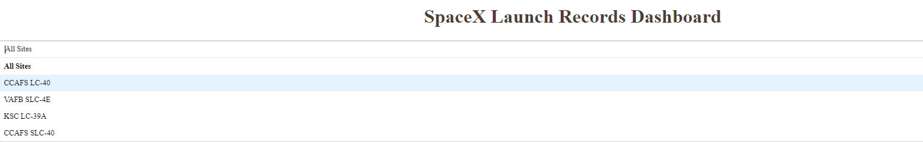
Launch Site Dropdown

Slide 40
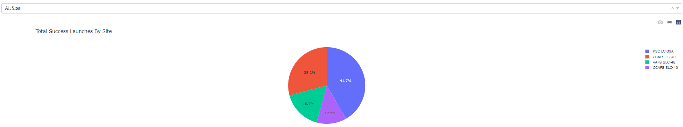
Pie Chart of All LaunchSite

Slide 41
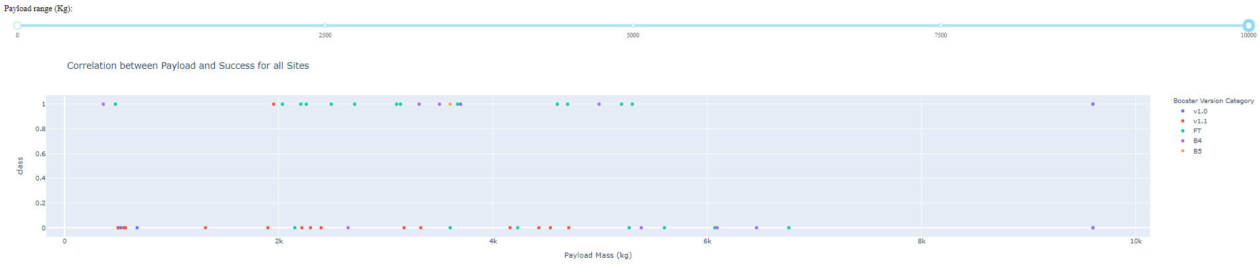
Scatter Plot

Slide 42

Section 5

Slide 43
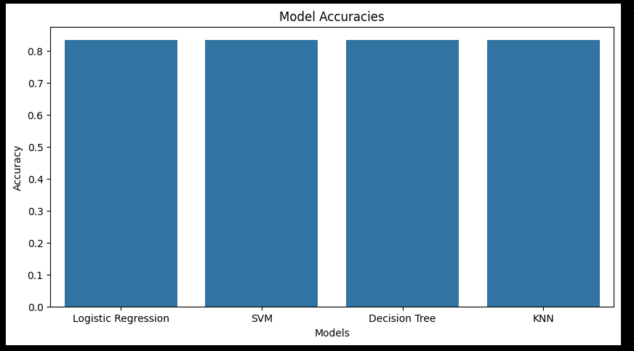
Classification Accuracy
All model have almost same accuracy in this process

Slide 44
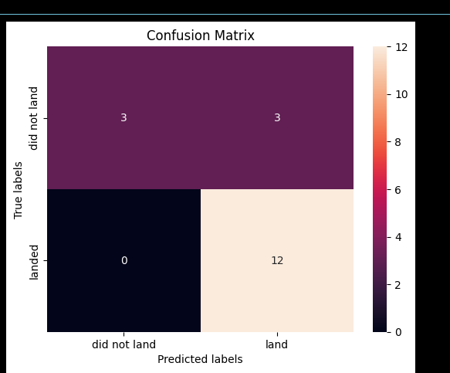
Confusion Matrix
This is the confusion matrix of Descision Tree

Slide 45


